Slide 1

ULHacks: Eduhub
A submission by: Kinukaiii, Man, Ra, and Seaweed

Slide 2
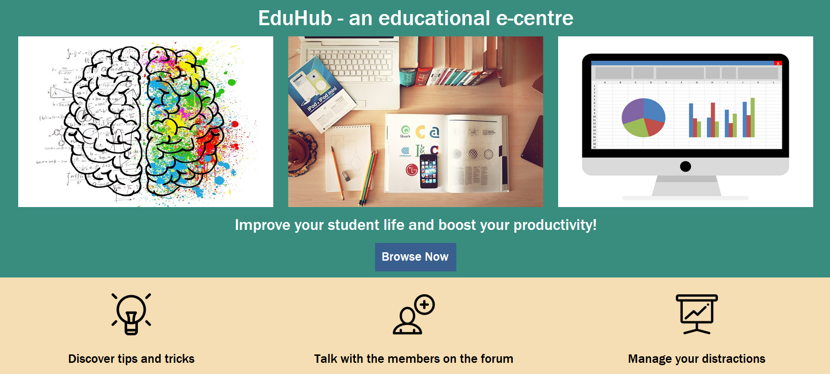
Eduhub, a productivity booster for students by students

Slide 3
Its features and how it works?

Slide 4
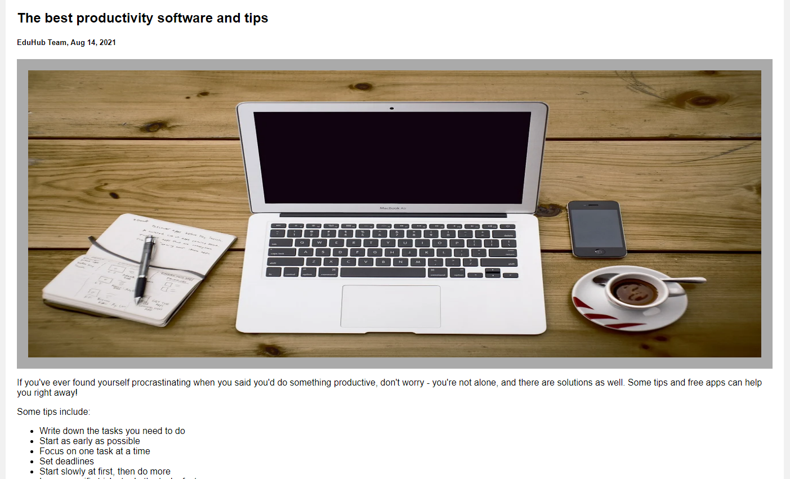
Productivity blog
Full of tips and tricks!
Posts are concise, minimizing time spent outside of work
A suite of apps are also recommended in an article!

Slide 5
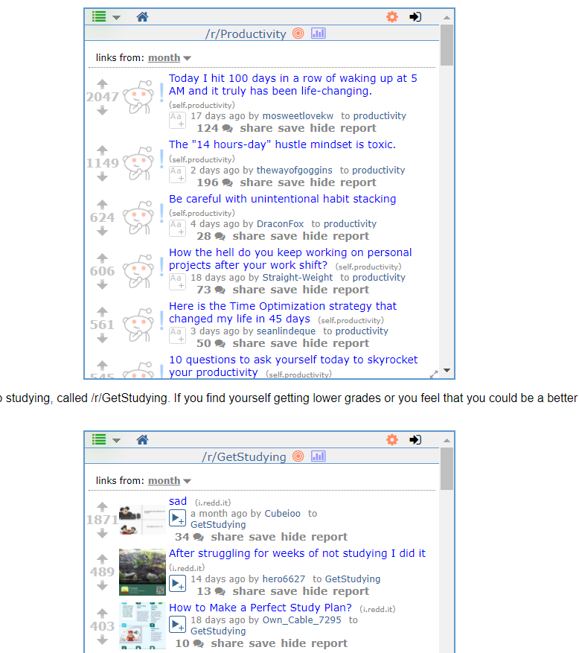
Live reddit feeds
Reddit feeds (a forum for any topic on Reddit) like r/Productivity and r/GetStudying available
Top posts available at a glance, reducing distractions

Slide 6
Forum
Chat with other students!
Did you know that group work has been scientifically proven to be more effective? As early as the 1920s, Harvard social psychologist Floyd Allport found that group work improved performance and motivation.
Relax from strenuous activity by catching up with a friend or stranger!

Slide 7
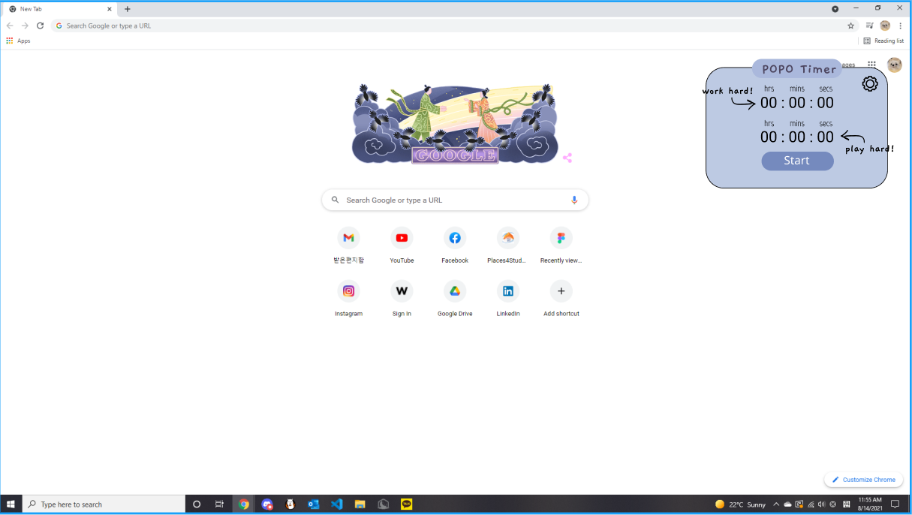
Chrome extension:
Our extension was a more extreme iteration of the “Pomodoro timer,” meant to induce anxiety and force students and employees to get things done
Our prototype design had three pages in Figma: one with the timer, another with the settings, and the last one with a pausable anxiety-inducing smiley face which would count down
Unfortunately, as we much later found out, it would only be possible to incorporate either the timer or the face
To make things worse, the clock was not entirely functional; it was able to be adjusted but would not count down. That fact coupled with our exhausted member who spent two sleepless nights working caused an executive decision to scarp the idea

Slide 8
How it works?
Eduhub functions as a central hub for a variety of productive tools, including a blog, forum, and Chrome/Firefox extension. The blog has an assortment of tips to help stay motivated during tasks. The forum adds a social aspect to encourage the sharing of ideas and techniques. Finally, the chrome extension is a fun twist which will guarantee a new experience every time one begins to work.

Slide 9

Inspiration
As quarantine takes its now almost year-long toll and the fall school year approaches, the necessity for high-quality and efficient work becomes more crucial. We wanted to think of a fun, exciting, creative and most importantly completely novel method of approaching education. We hope our unconventional creations manage to surprise you!

Slide 10
Struggles:
Two of our members had minimal coding experience and were attending their first hackathon
We also were spread out across various time zones, resulting in asynchronous work
We experienced serious issues with the chrome extension in the last stretch, and had to scrap it from our final product
We severely underestimated the time necessary to complete the chrome extension

Slide 11
GitHub link:
https://github.com/vladcranga/ulhacks-hackaton
https://github.com/vladcranga/ruby-forum (forum)

Slide 12

Thank you for listening!

